Slide 1
Camp Alexander Mack
2021 Camp Rep Meeting
Keep Microphone Muted until Q and A Session
Use Headphones for best sound quality
Set View to “Speaker View”
Meeting will be recorded and available for later viewing
Questions maybe be submitted at anytime through chat

Slide 2
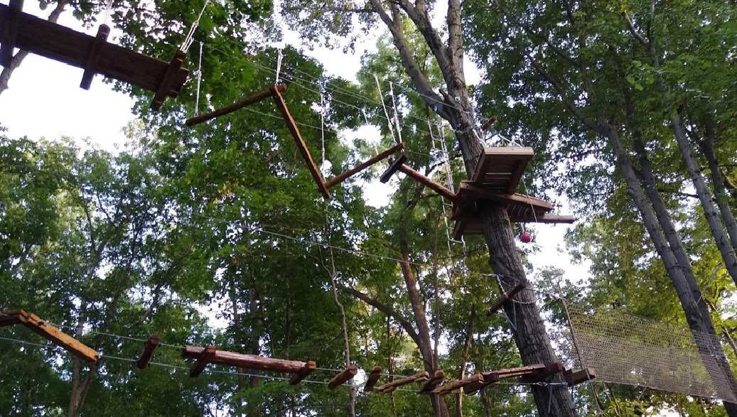
Welcome and Updates
Gene Hollenberg

Slide 3
Registration Process
February 1st: Pre-Registration for those who forwarded deposits
February 15th: Registration opens for all
$75 nonrefundable deposit required to hold spot
Capacity is limited
Registration Tutorial Videos are linked on the Camp Rep page

Slide 4
Church Transfer Codes
Talk with your church leadership about how much of a camper’s fees your church will cover.
Complete the gold sheet either online at campmack.org/camp-rep or the paper copy in your camp rep packet and return it to Camp.
Camp will contact you with your transfer code(s)
Share your transfer code for your church with your campers.
Check the online church portal to make sure your campers registered
Receive an invoice listing all your campers on March 30th
Send a payment for your church’s balance to Camp Mack.

Slide 5
Preparing for Camp
Jessie Kreider

Slide 6
Drive Thru Check In Process
Expanded Health Check
Parents will not be allowed in cabins
Caravan is better than Carpool
Staggered Check in Times
Subject to Change
Please Check Campmack.org/covid for updates

Slide 7
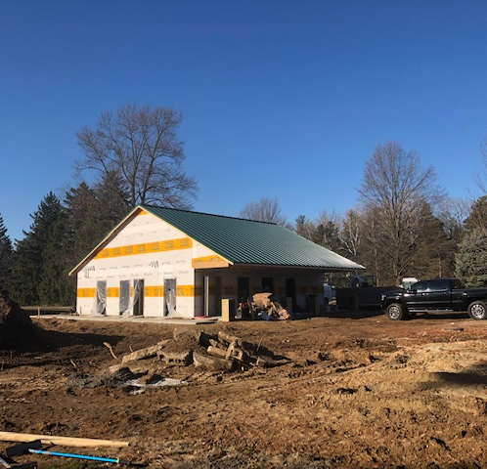
Summer 2021 Camp Experience
NPI
(Nonpharmaceutical interventions)
Screening
Cohorting
Sanitizing
Face Masks
Ventilation
Physical Distancing
Hand Hygiene

Slide 8
Camp Alexander Mack
2021 Camp Rep Meeting
Will Resume at
10:30

Slide 9
Summer Staff 2021
Summer Staff
Ages 18+
Multiple Positions Available
Through out the summer
Possible work areas:
Facility
Lifeguard
Kitchen
Paid Counselors
Ages 21+
14 Positions Available
June 20- July 30
Lead and live with
campers grades 1st-9th
Who do you know that might be interested?

Slide 10
Fundraising Update
While 2020 was difficult,
We did not have to layoff any staff

Slide 11
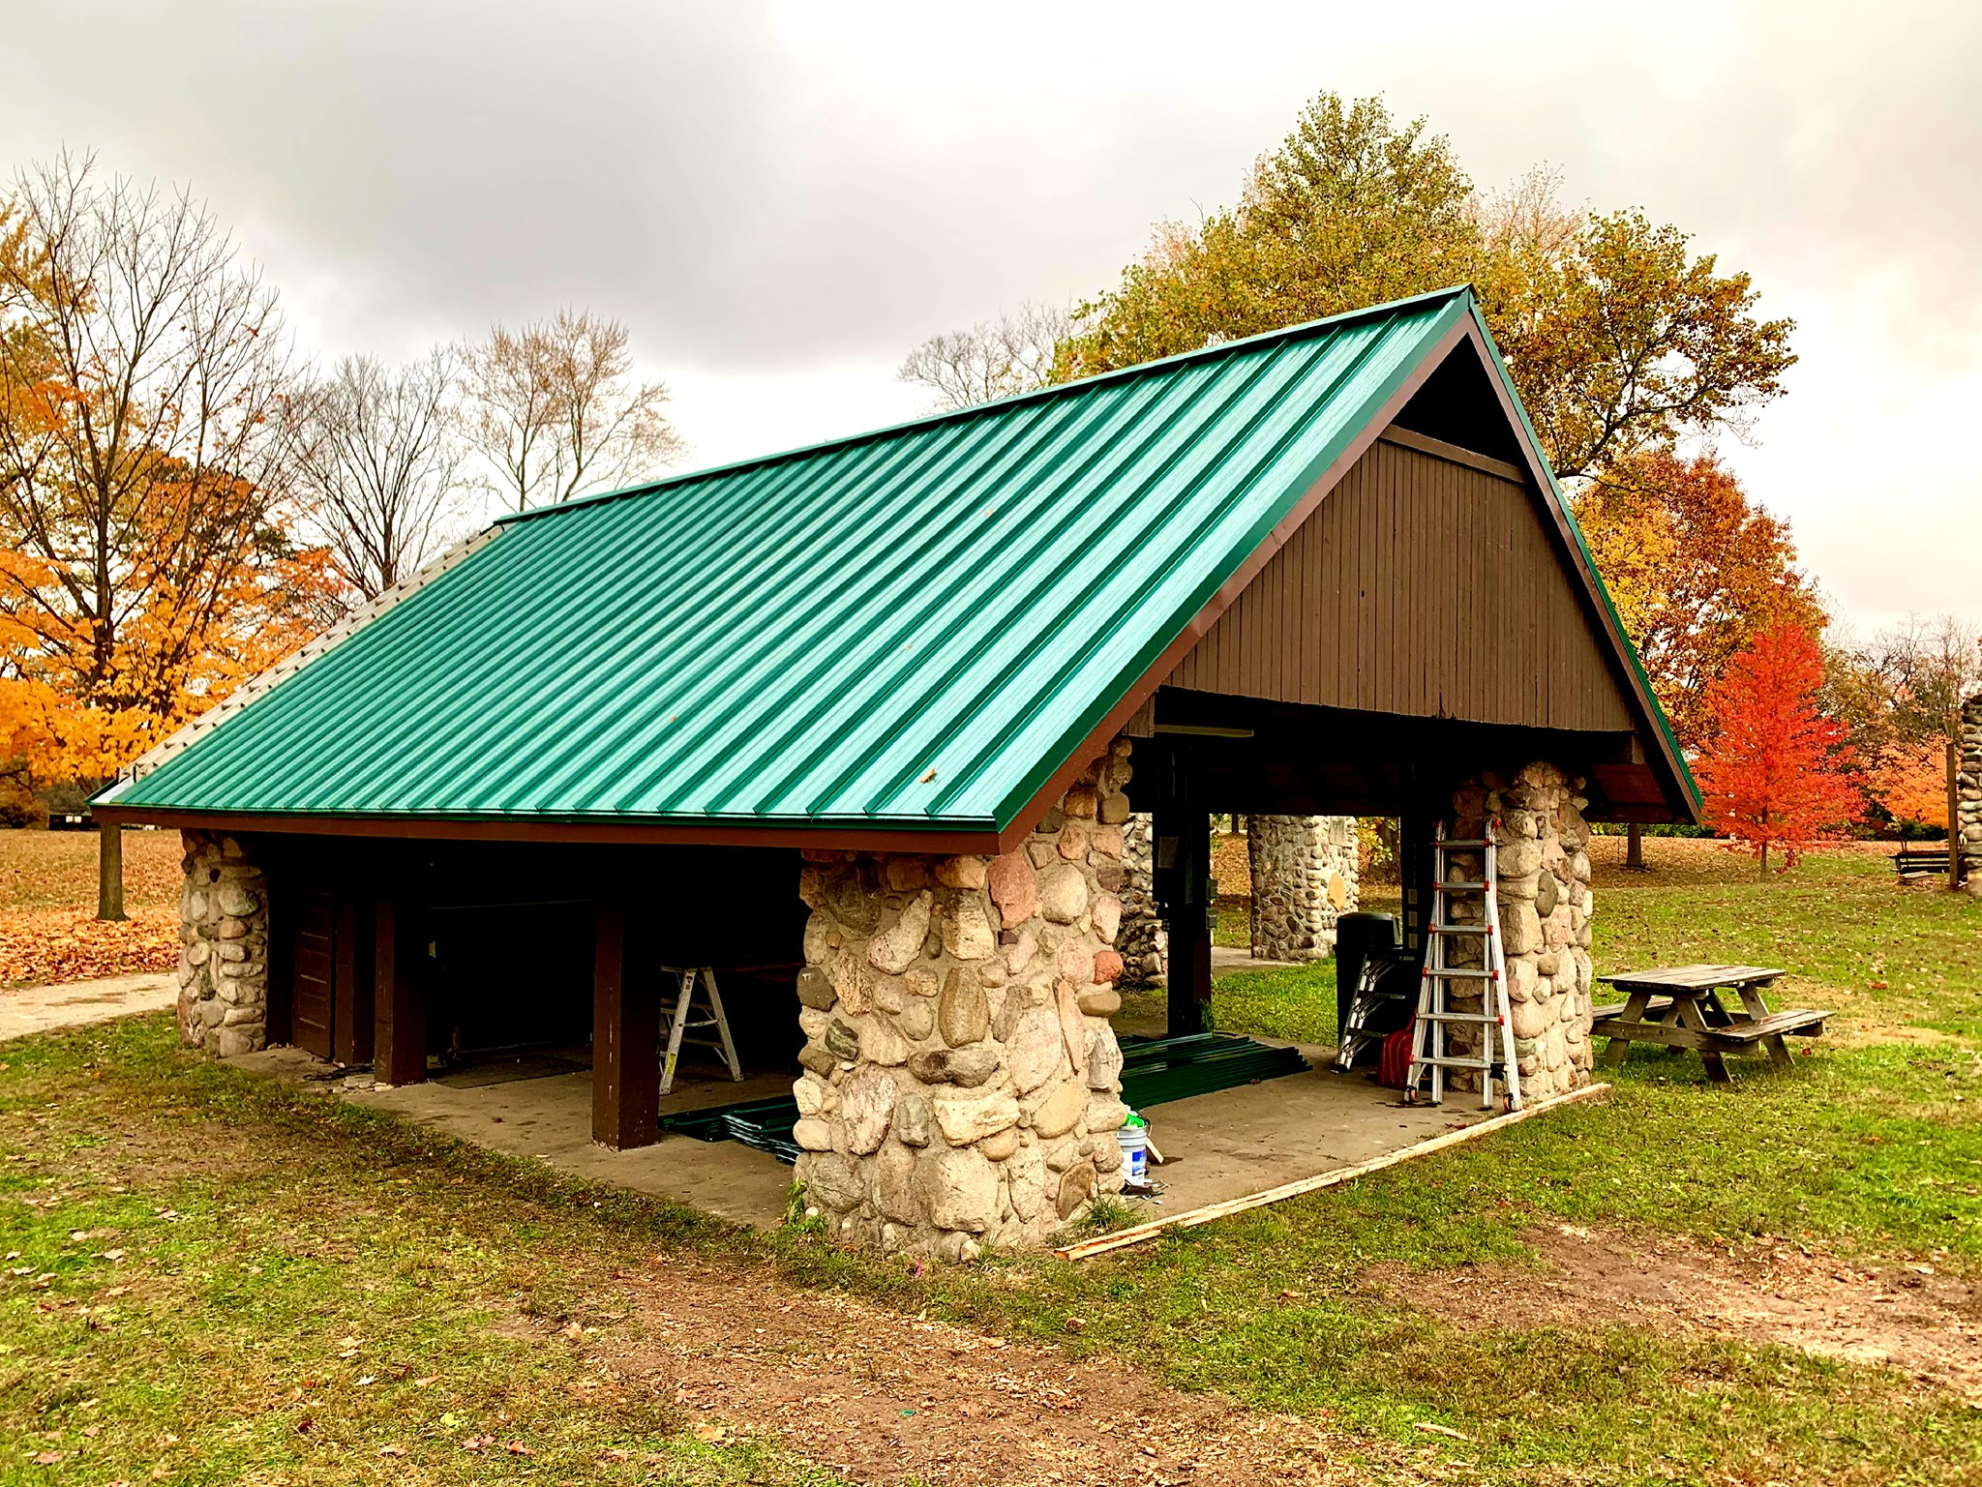
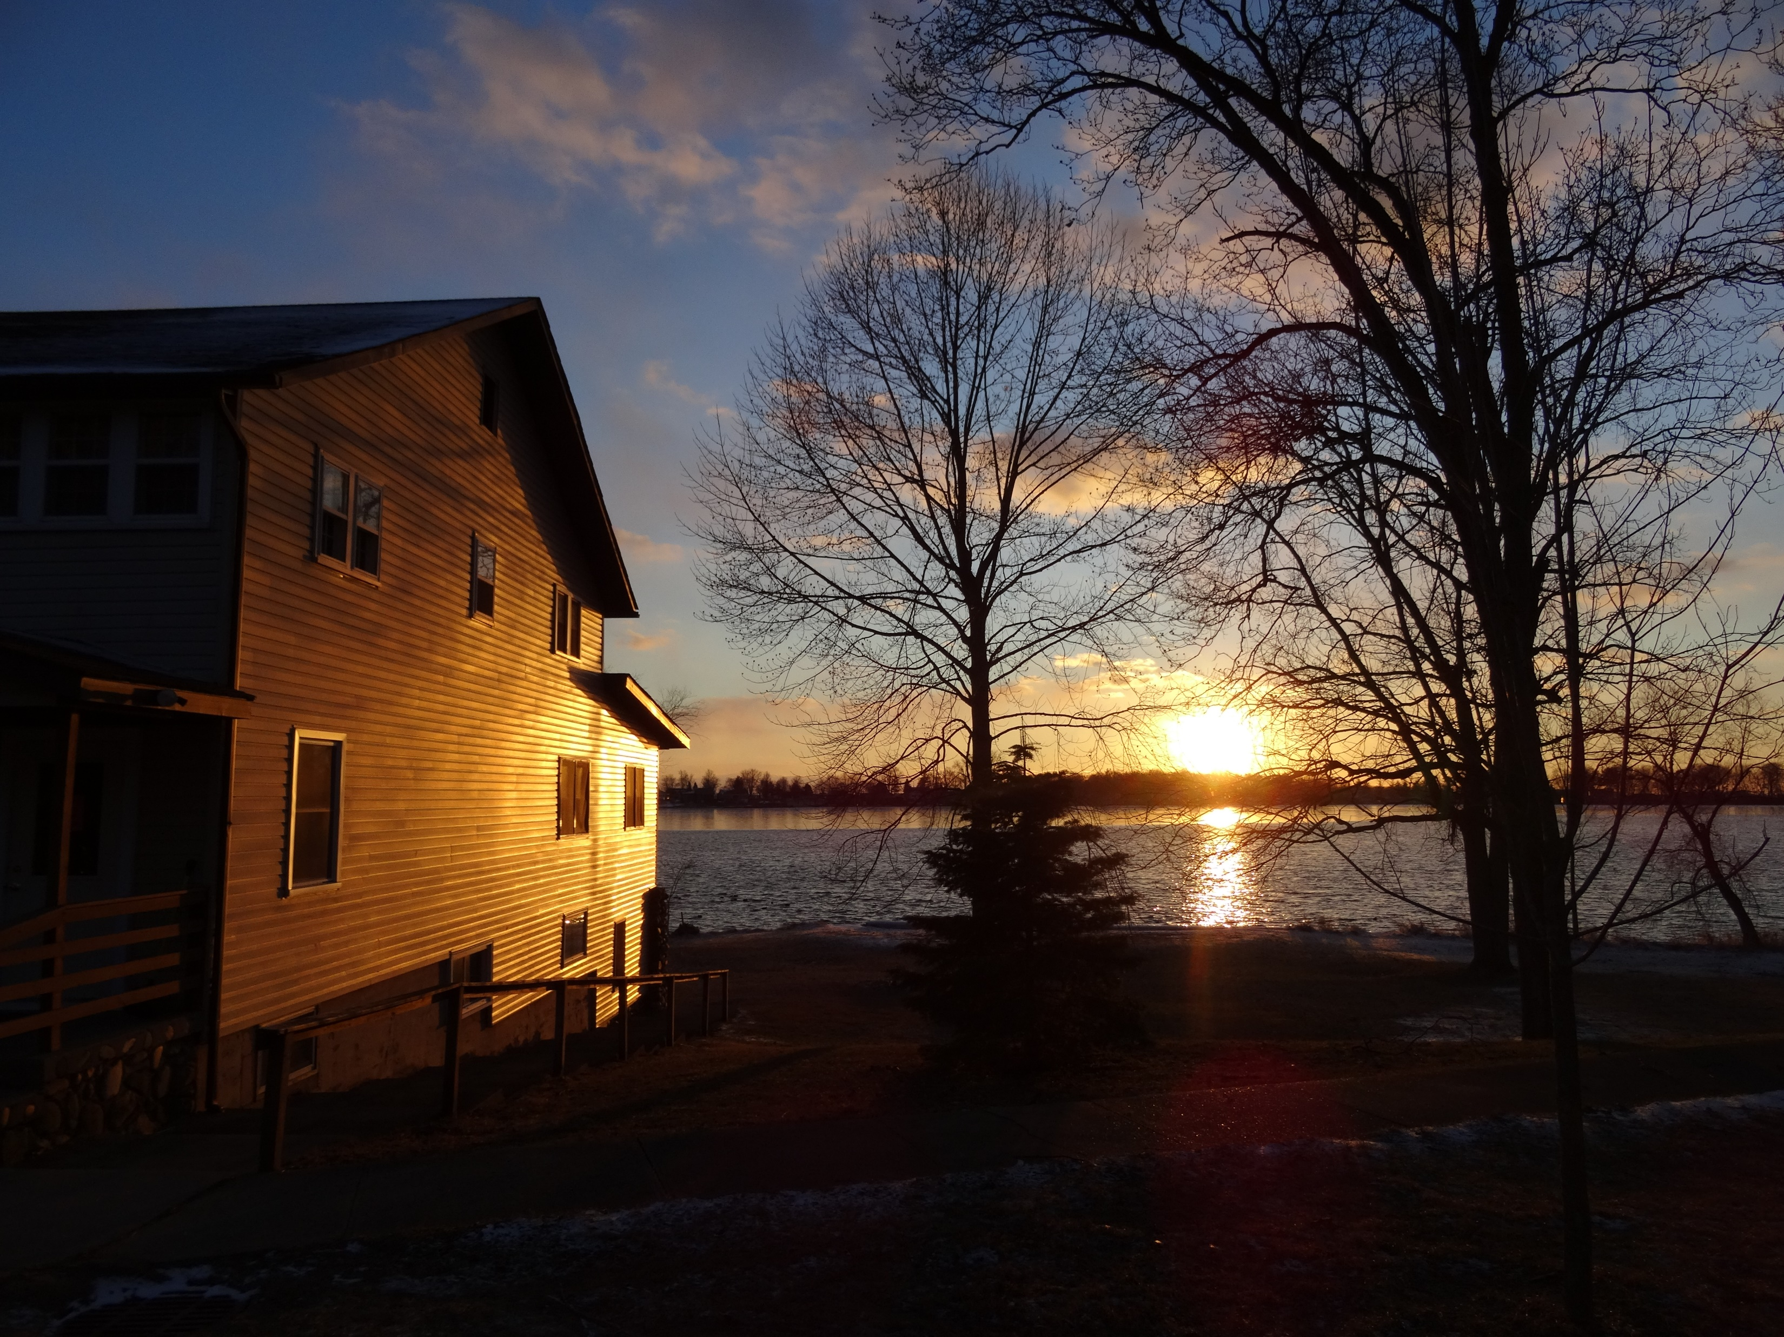
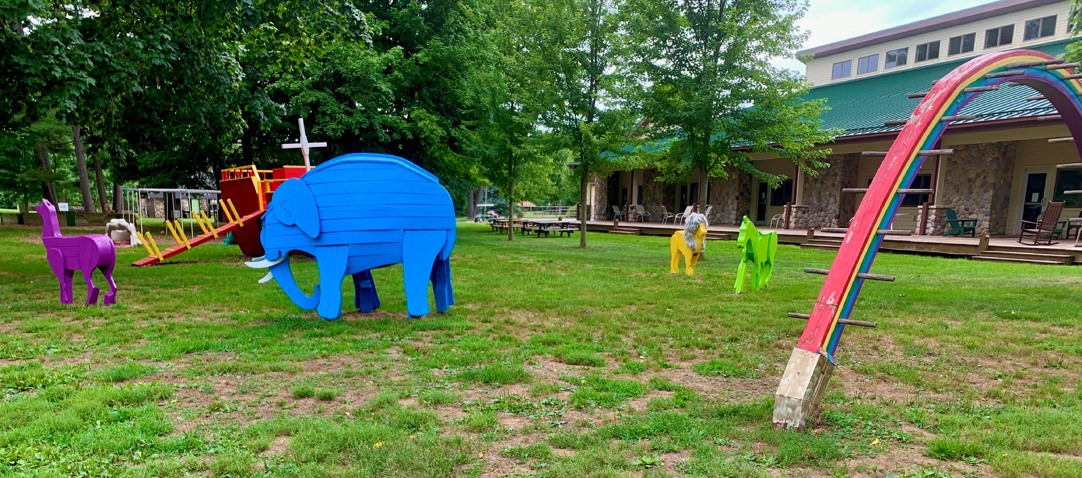
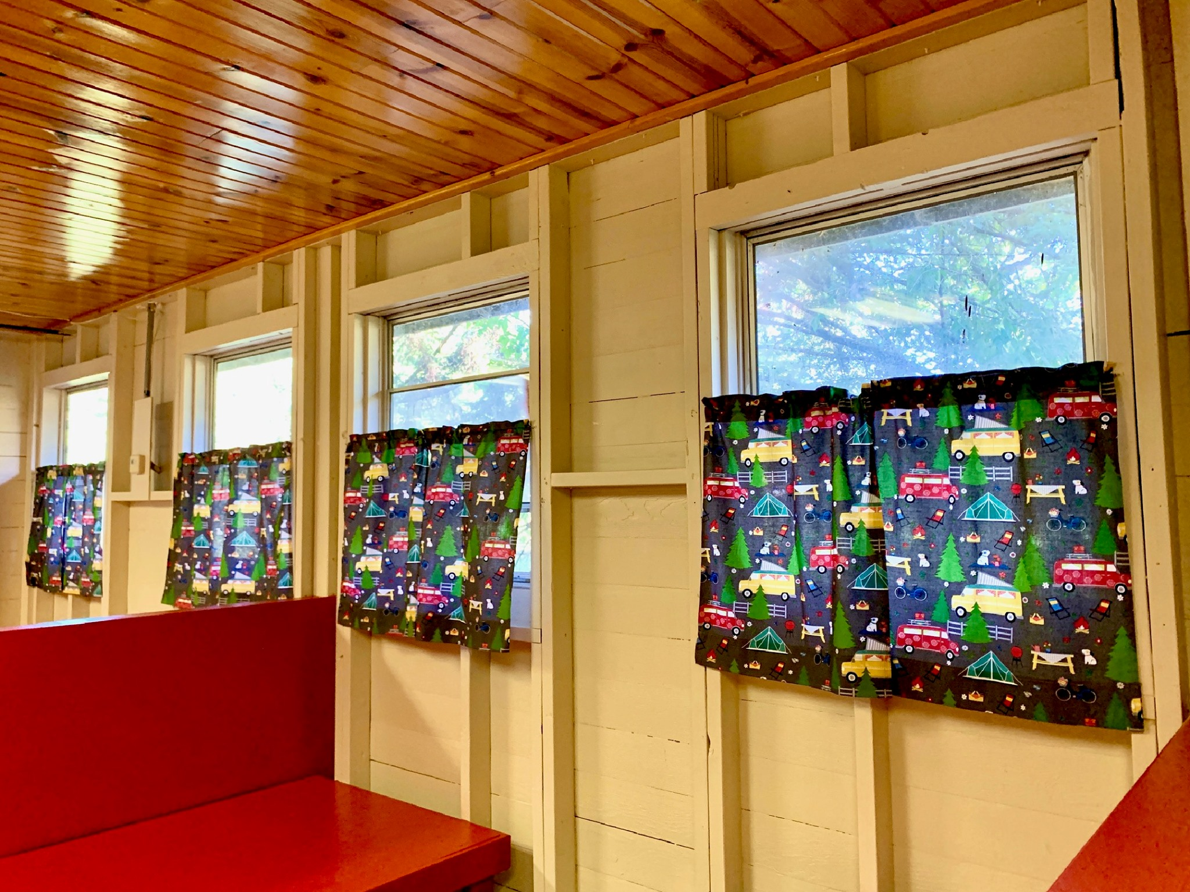
Projects Funded by Direct Gifts
Jacob’s Well Roof
Sarah Major Windows
From Union Center Church of the Brethren and Others
From an Anonymous Donor
Painted Arky Parky Animals
Painted W Cabins
In memory of Verne Leininger

Slide 12
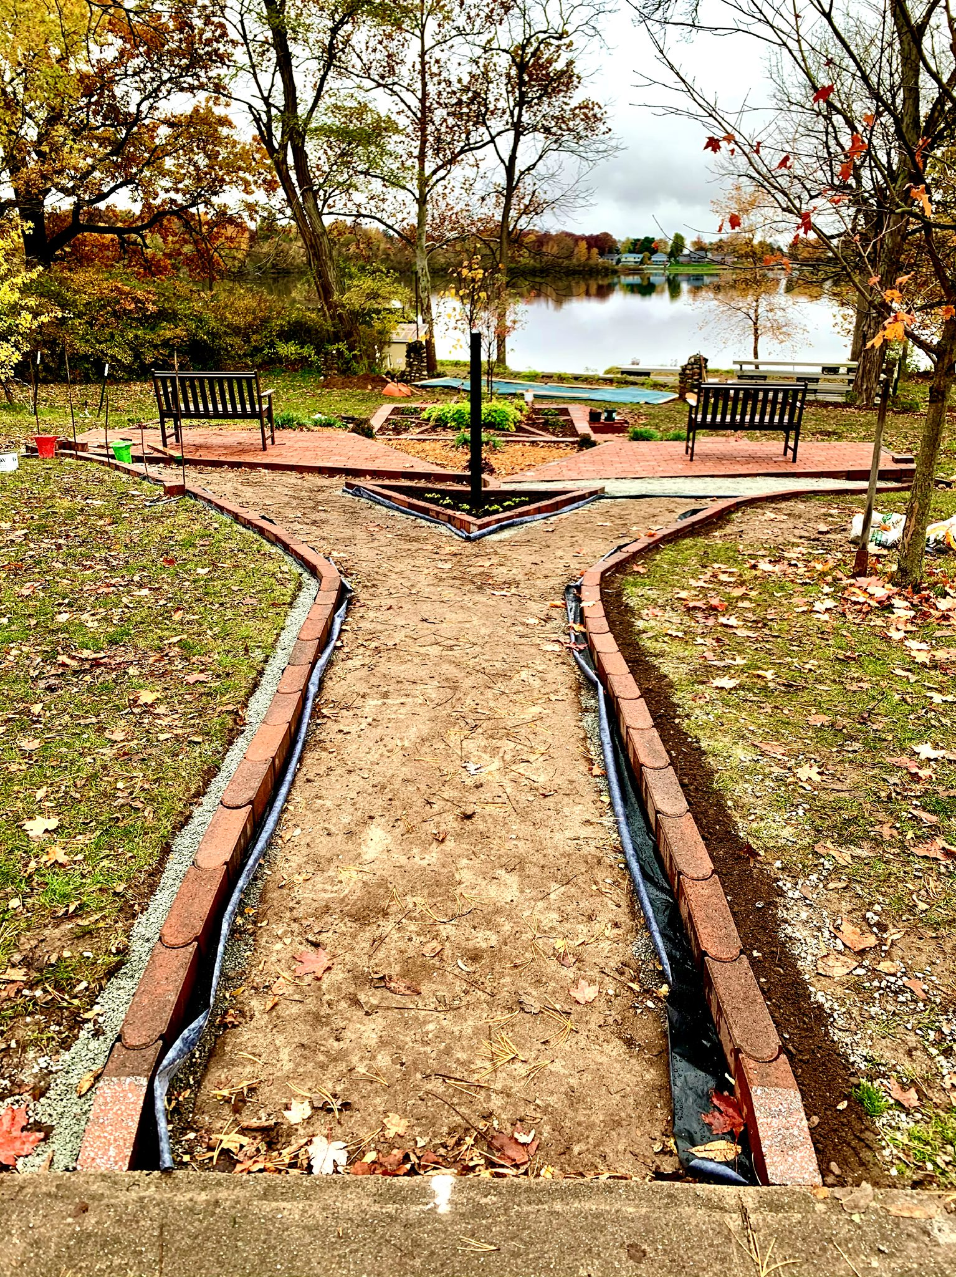
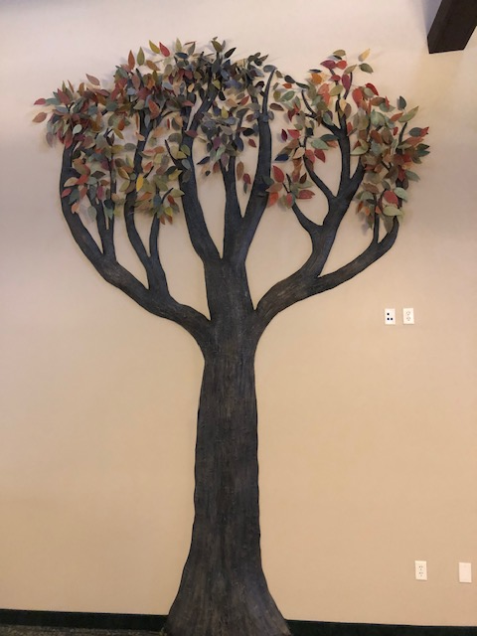
Projects Funded by Planting the Future
Peace Garden
Esther and John Hamer Health Center
Donor Tree

Slide 13
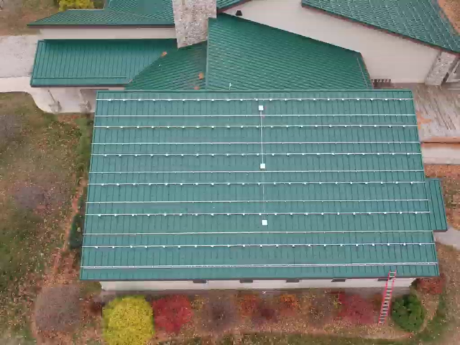
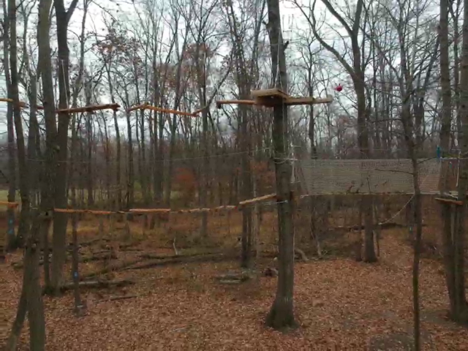
Projects Funded by Unique Sources
Installation of Solar Panels
New High Ropes Course
Loan from Financial Institution
Grant from the K21 Foundation

Slide 14
2021 Capital Project List
Replace the roof on Shultz Chapel
Replace the upper roof on Sarah Major Lodge
Stonework repair on Quinter-Miller foundation
Replace the boiler in Sarah Major Lodge
Replace the water heater in Sarah Major Lodge
Replace the HVAC in the South Residence
Replace the water softener in Sarah Major Lodge
Remodel the upstairs women’s restroom in Sarah Major Lodge
Replace the HVAC in Wampler Retreat Center
Repair the electrical system in the East Stone restroom
Repair the deck on the John Kline Welcome Center
Repair the boardwalk in the wetlands
Complete the communications display in the John Kline Gathering Room
Repair the Mission Village boardwalk

Slide 19
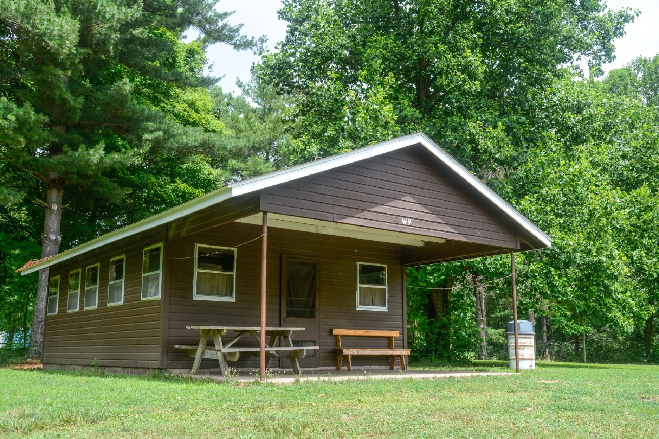
Renting Camp Mack
Constitutional Camps

Slide 20
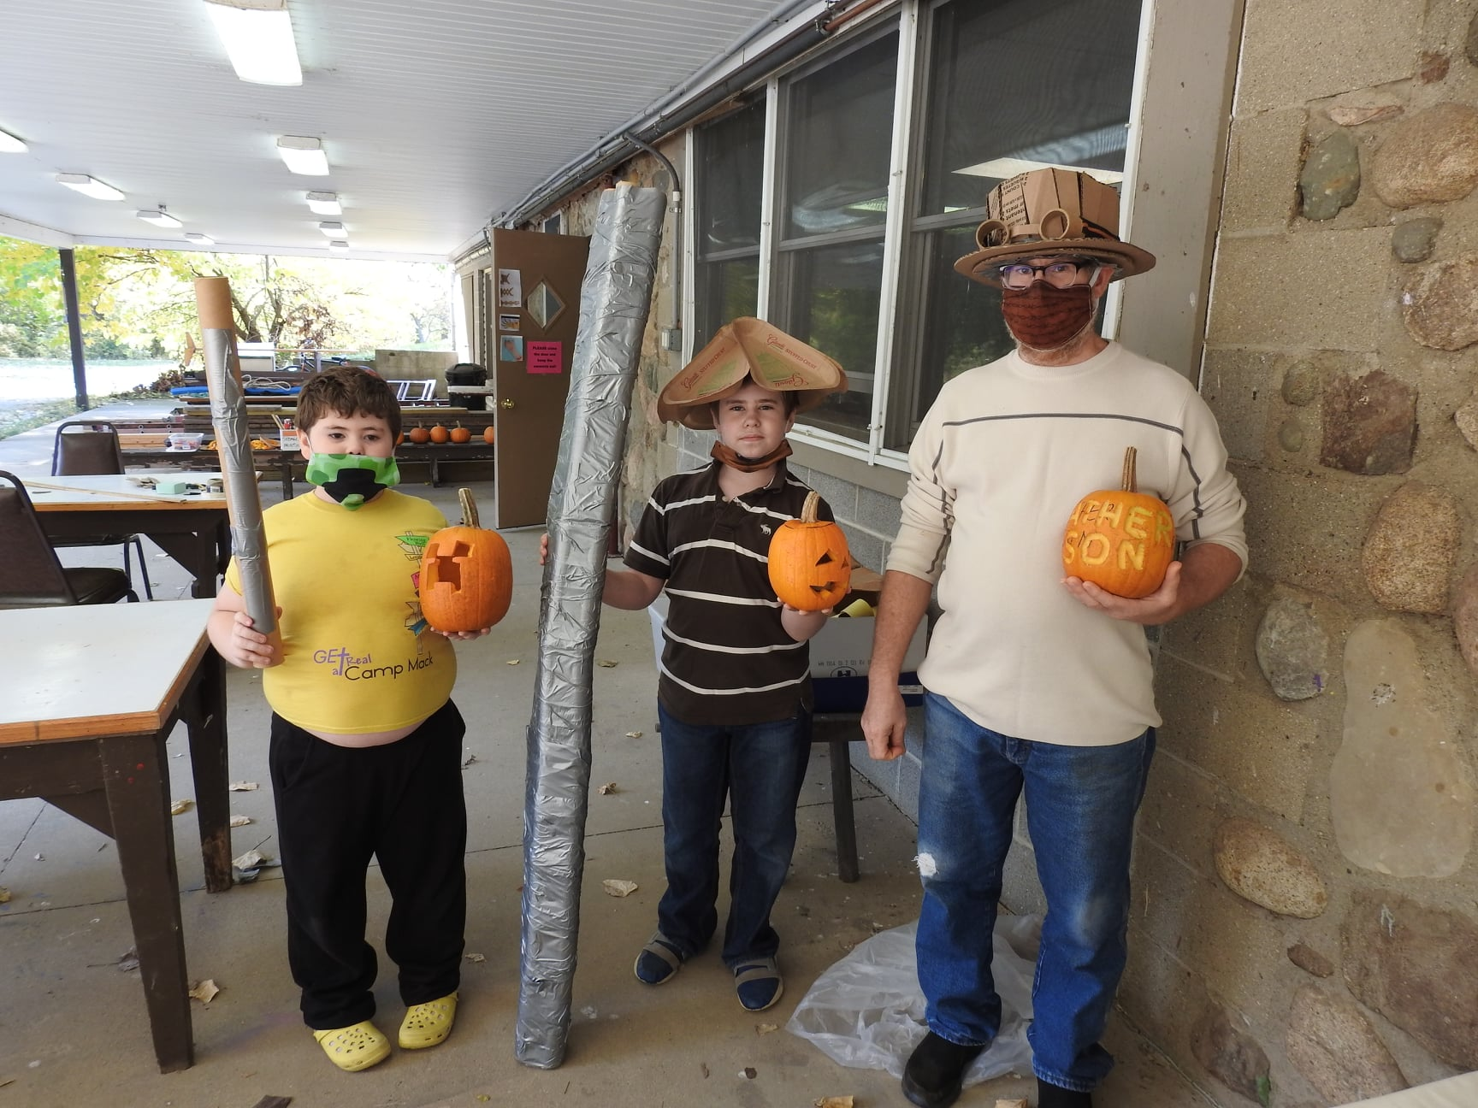
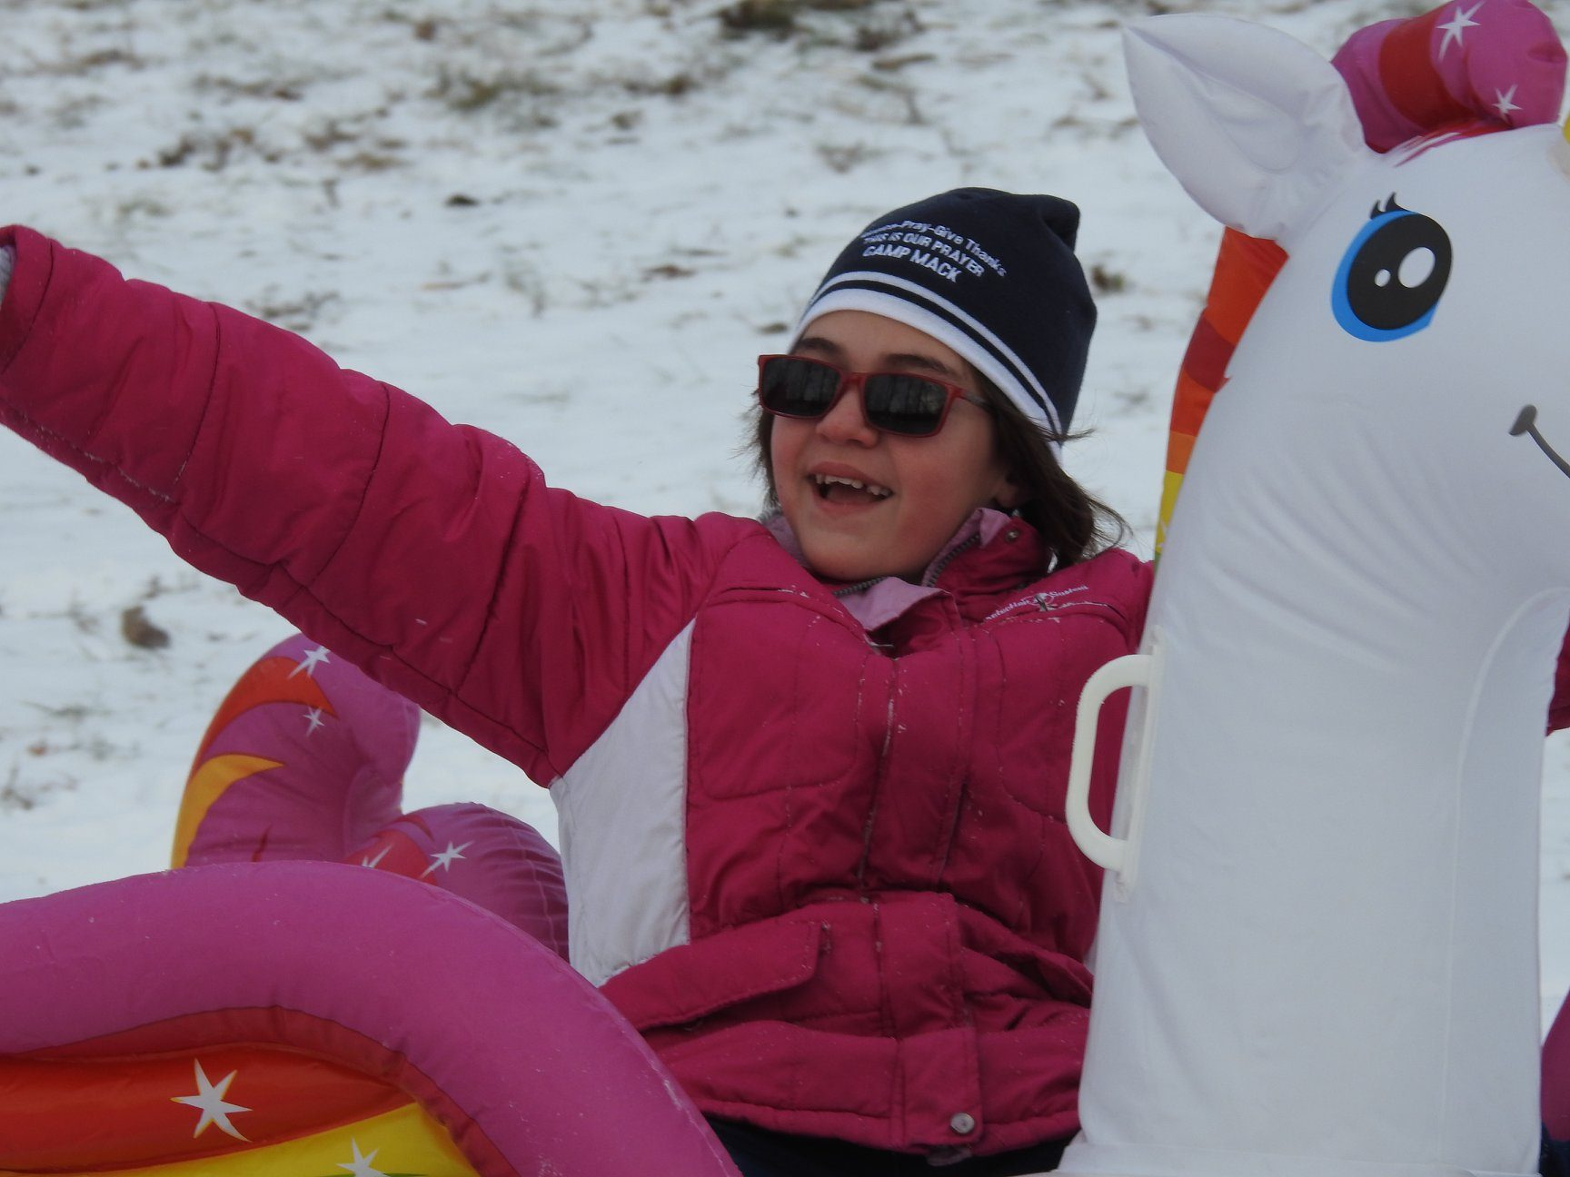
Get-A-Way Days
Retreat Season Programming

Slide 21
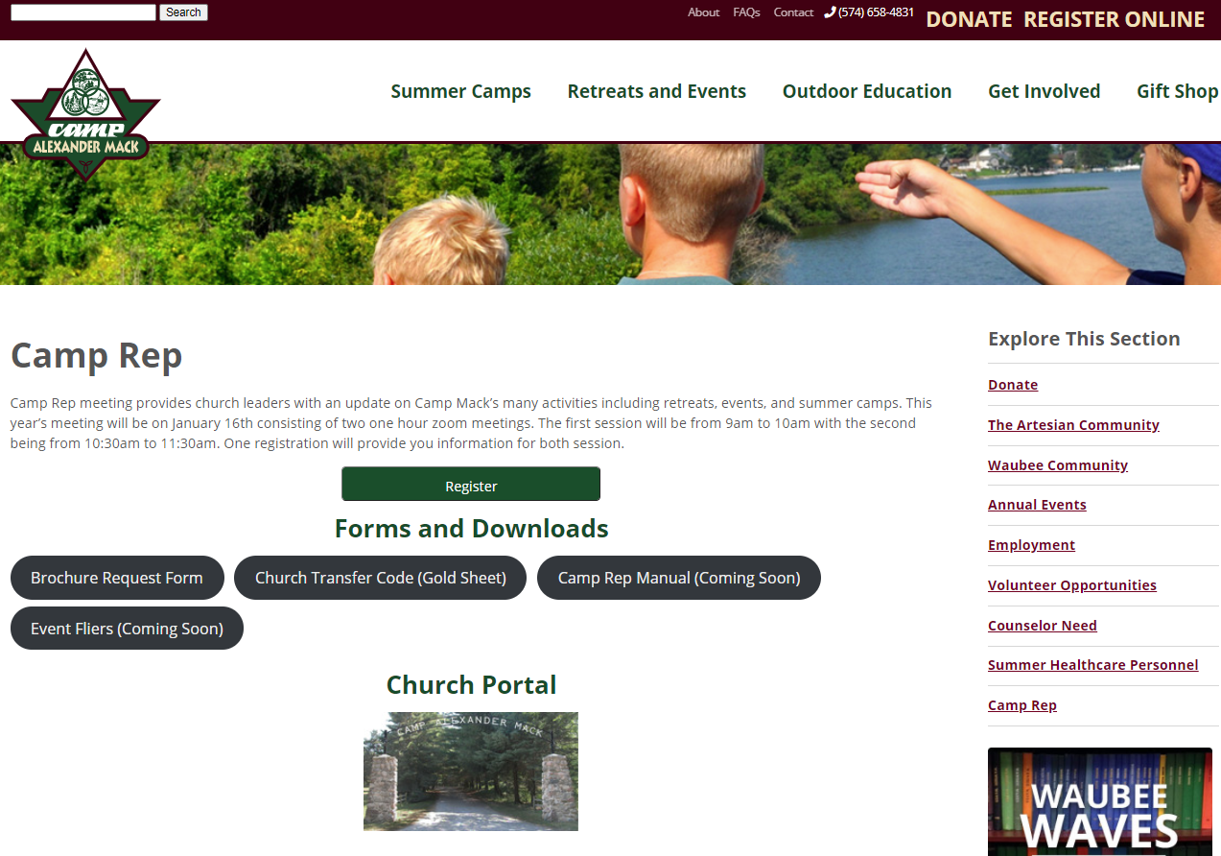
Campmack.org/camp-rep
Please Complete:
Brochure Request Form
Church Transfer Code (Gold Sheet)

Slide 22
Summer 2021 Questions with Jessie
Camp Mack Questions with Gene
New Camp Rep Welcome
Deanna

